Slide 1



Slide 2


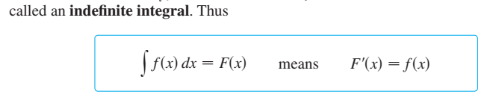
Integration

Slide 3
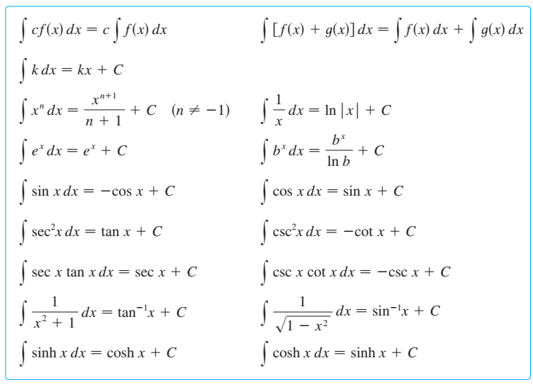

Slide 4
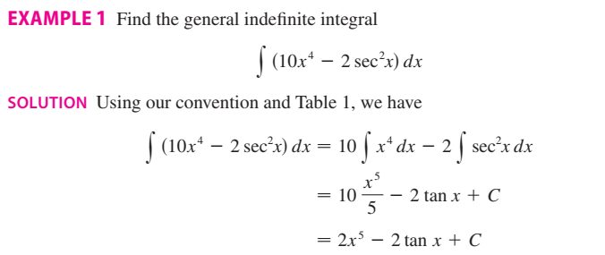

Slide 5

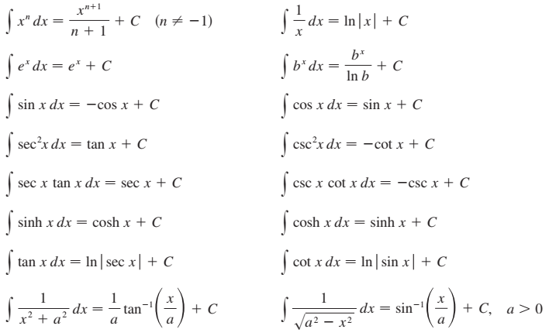

Slide 6

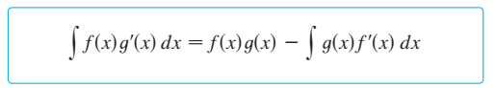
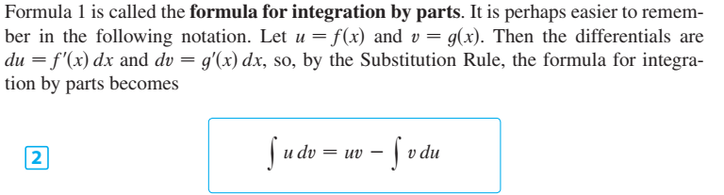

Slide 7
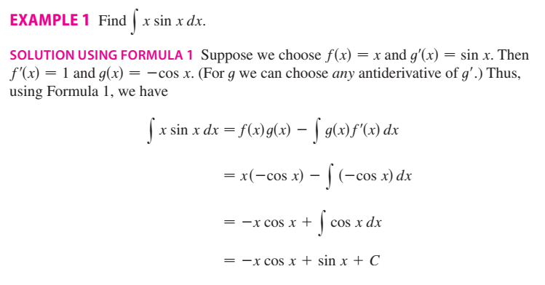

Slide 8
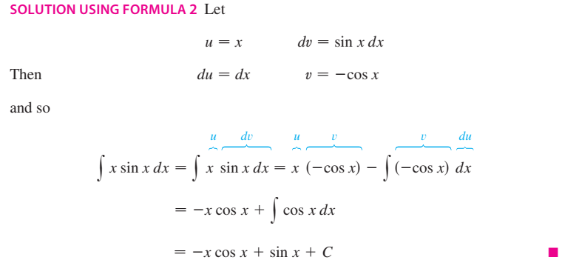
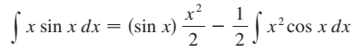

Slide 10
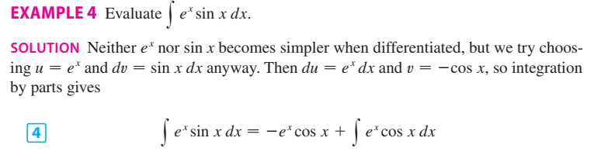
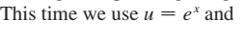
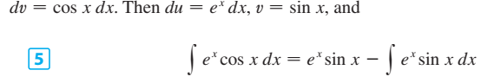
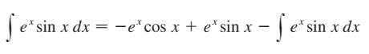
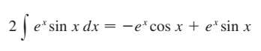
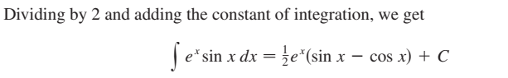

Slide 11
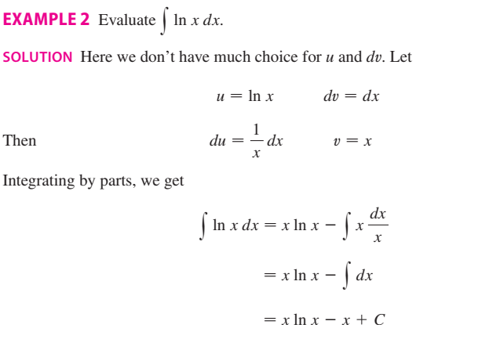

Slide 12

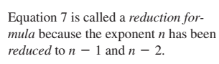
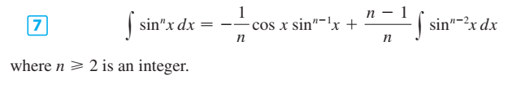
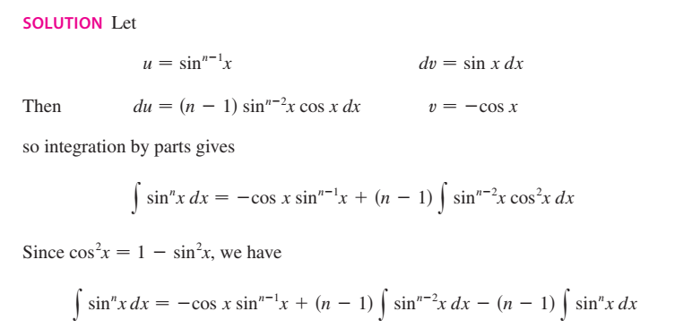

Slide 13
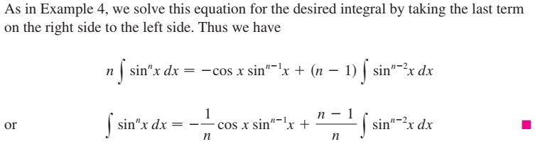
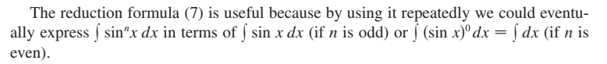

Slide 14
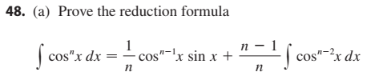
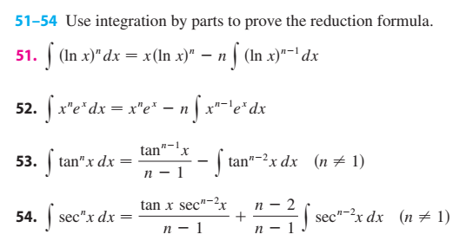

Slide 15

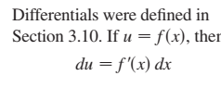
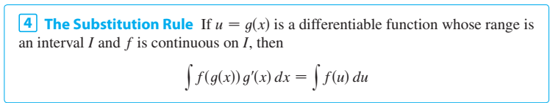
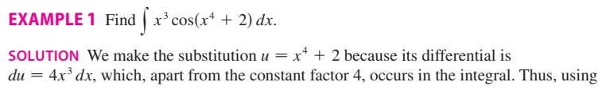
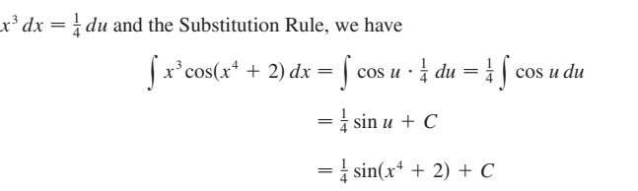

Slide 16
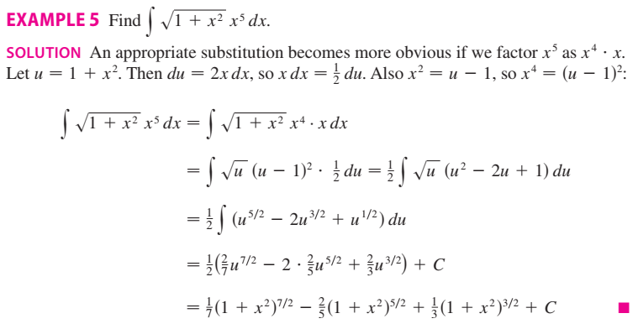

Slide 17

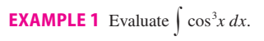
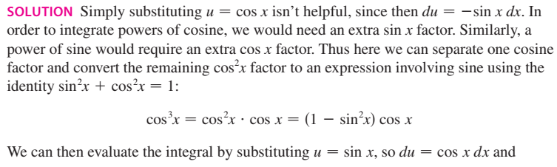
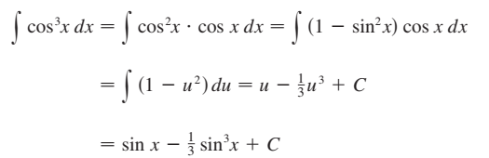

Slide 18
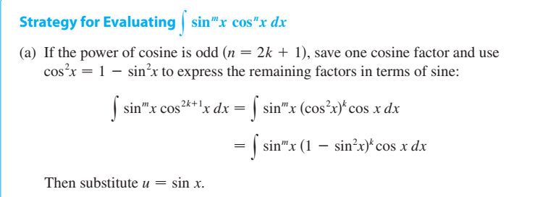
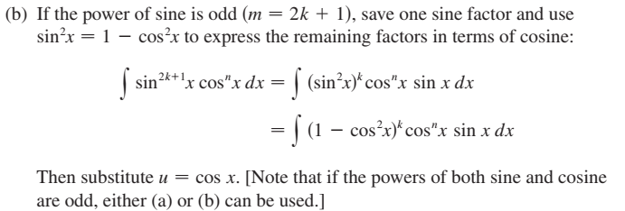

Slide 19
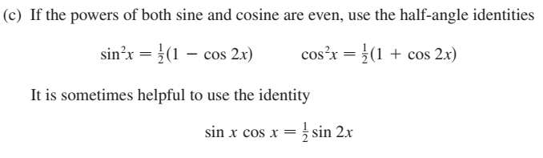

Slide 20
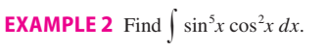
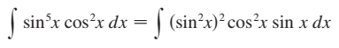
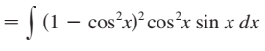
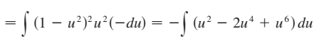
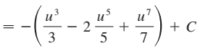
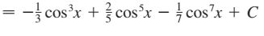

Slide 21
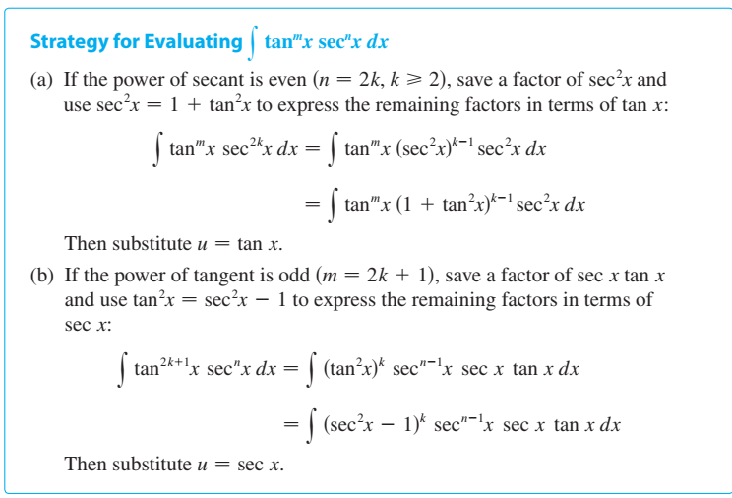

Slide 22
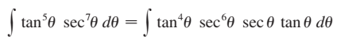
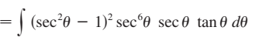
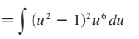
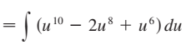
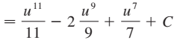
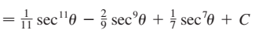

Slide 23
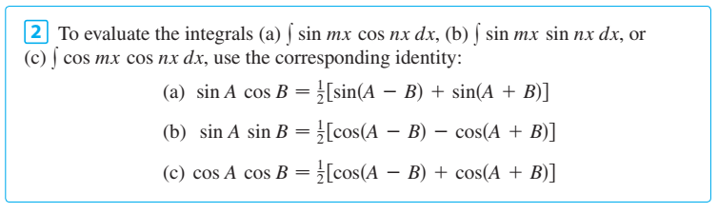
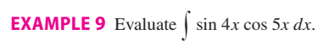
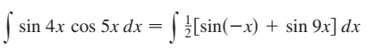



Slide 24




Slide 25








Slide 26




Slide 27





Slide 28











Slide 29









Slide 30





Slide 31





General Method

Slide 32







Slide 33




Slide 34




Slide 35







Slide 36





Slide 37





Slide 38






Slide 39




Slide 40





Slide 41






Slide 42




Slide 43




Slide 44





Slide 45





Slide 46




Slide 47





Slide 48



Slide 49


Slide 50



Slide 51



Slide 52



Slide 53


Slide 54



Slide 55




Slide 56


Slide 57


Reimann sum and Definite integrals

Slide 58


Slide 59



Slide 60



Slide 61



Slide 62




Slide 63




Slide 64





Slide 65




Slide 66





Slide 67


Slide 68




Slide 69



Slide 70




Slide 71



Slide 72





Slide 73



Slide 74



Slide 75



Slide 76




Slide 77



Slide 78




Slide 79


Slide 80



Slide 81




Slide 82


Slide 83



Slide 84




Slide 85



Slide 86



Slide 87



Slide 88




Slide 89



Slide 90




Slide 91




Slide 92



Slide 93




Slide 94



Slide 95






Slide 96



Slide 97





Slide 98




Slide 99





Slide 100






Slide 101




Slide 102



Slide 103





Slide 104





Slide 105



Slide 106



Slide 107




Slide 108


Slide 109


Slide 110



Slide 111




Slide 112





Slide 113




Slide 114


Slide 115



Slide 116





Slide 117



Slide 118



Slide 119



Slide 120



Slide 121



Slide 122


Slide 123


Slide 124





Slide 125





Slide 126




Slide 127



Slide 128



Slide 129


Slide 130



Slide 131


Slide 132



Slide 133



Slide 134
The End

